Slide 1
Week 17: Inheritance
Improving structure with inheritance.

Slide 2
Java
We have now covered the "core" of Java.
We have three remaining things to do:
Explore the (vast) library of classes available in Java.
Explore ways to develop more sophisticated object interactions.
Discuss Methodology and structured programming
Remember that the "trick" in programming is to spot patterns.

Slide 3
Code Reuse
"Code reuse" is an often-claimed benefit of object-oriented programming.
The idea goes that we develop a class, and that class can then be used in many applications.
Often this means that the base class is rather generic, and that we specialise the class to fit the application.

Slide 4
Inheritance
We inherit some characteristics from our parents.
Other characteristics are specific to us.
Siblings all inherit from their parents.
In programming, inheritance is a process where a class acquires the properties (methods and attributes) of another.

Slide 5
Java Class Libraries
This concept is not new to us.
Check the top of the ArrayList docs:
https://docs.oracle.com/javase/8/docs/api/java/util/ArrayList.html
An ArrayList is an AbstractList is an AbstractCollection is an Object.
"Everything" in Java is eventually a java.lang.Object. Everything inherits from Object and often other classes

Slide 6
Java Class Libraries
So this idea of inheritance is at the core of Java.
Now we are going to see how to use it to make our programming lives easier.

Slide 7
Bank Accounts
Last week in the practical you developed a collection of classes that could be used in a "Bank" application.
You probably noticed that several of the classes you wrote contained identical code.
You might have found all the copying-and-pasting to be tedious and error-prone.
There was a definite code smell, which we don’t like!

Slide 8
Bank Accounts
Inheritance will ease this pain for us.
Using inheritance, we would define a generic bank account, and then specialise it for different specific types of account.

Slide 9
Bank Accounts
All bank accounts have a balance, account number, account holder.
So these all go in a base class - call it BankAccount - with constructor, getters, setters, toString and so on.

Slide 10
Bank Accounts
Current accounts handle overdrafts, so must be a derived class (CurrentAccount). But we write only what is specific to Current accounts.
Both current accounts and deposit accounts allow deposits (the rules are the same), so this logic can go in BankAccount.

Slide 11
Bank Accounts
Therefore, We say that CurrentAccount specialises (or just "inherits from") BankAccount.
CurrentAccount then inherits the common attributes and methods of BankAccount in addition to the things which are unique to it.

Slide 12
Bank Accounts
Clearly, we want both CurrentAccount and DepositAccount to have sensibly named methods for deposit and withdraw.
Notice also that in the hierarchy we are developing, there is actually no such thing as a generic BankAccount.
There is no need to create an instance of BankAccount, the account types we need are the ones we developed last week.

Slide 13
A Social Network
To illustrate this, imagine a simple "News Feed" on a social networking site.
Users add "Posts" to the feed.
Posts may be:
Text
Pictures
Videos

Slide 14
A Social Network
We will have a generic class "Post".
And there are three more specialised classes: TextPost, PicturePost, VideoPost.
All Posts (of whatever type) have a user, a number of "likes" and might have comments added, these will be in the “Post” class.

Slide 15
A Social Network
Text posts contain a string of textual data, and nothing else.
Picture posts don't have a message. They have the name of an image file, and maybe a caption.
Video posts are much the same as Picture posts, but may also have attributes such as duration.
All of these classes will inherit the common attributes from the “Post” class and of course have unique attributes and methods.

Slide 16
Design
To keep things simple, we first ignore video posts.
As a first design, we could decide:
A NewsFeed is made up of posts, stored in an ArrayList.
Posts may be of one of two kinds:
MessagePost: a multiline text message.
PhotoPost: an image filename and a caption.

Slide 17
Design
To keep things simple, we first ignore video posts.
As a first design, we could decide:
A NewsFeed is made up of posts, stored in an ArrayList.
Posts may be of one of two kinds:
MessagePost: a multiline text message.
PhotoPost: an image filename and a caption.
Since the two kinds of post are different, two ArrayLists will be needed???

Slide 18
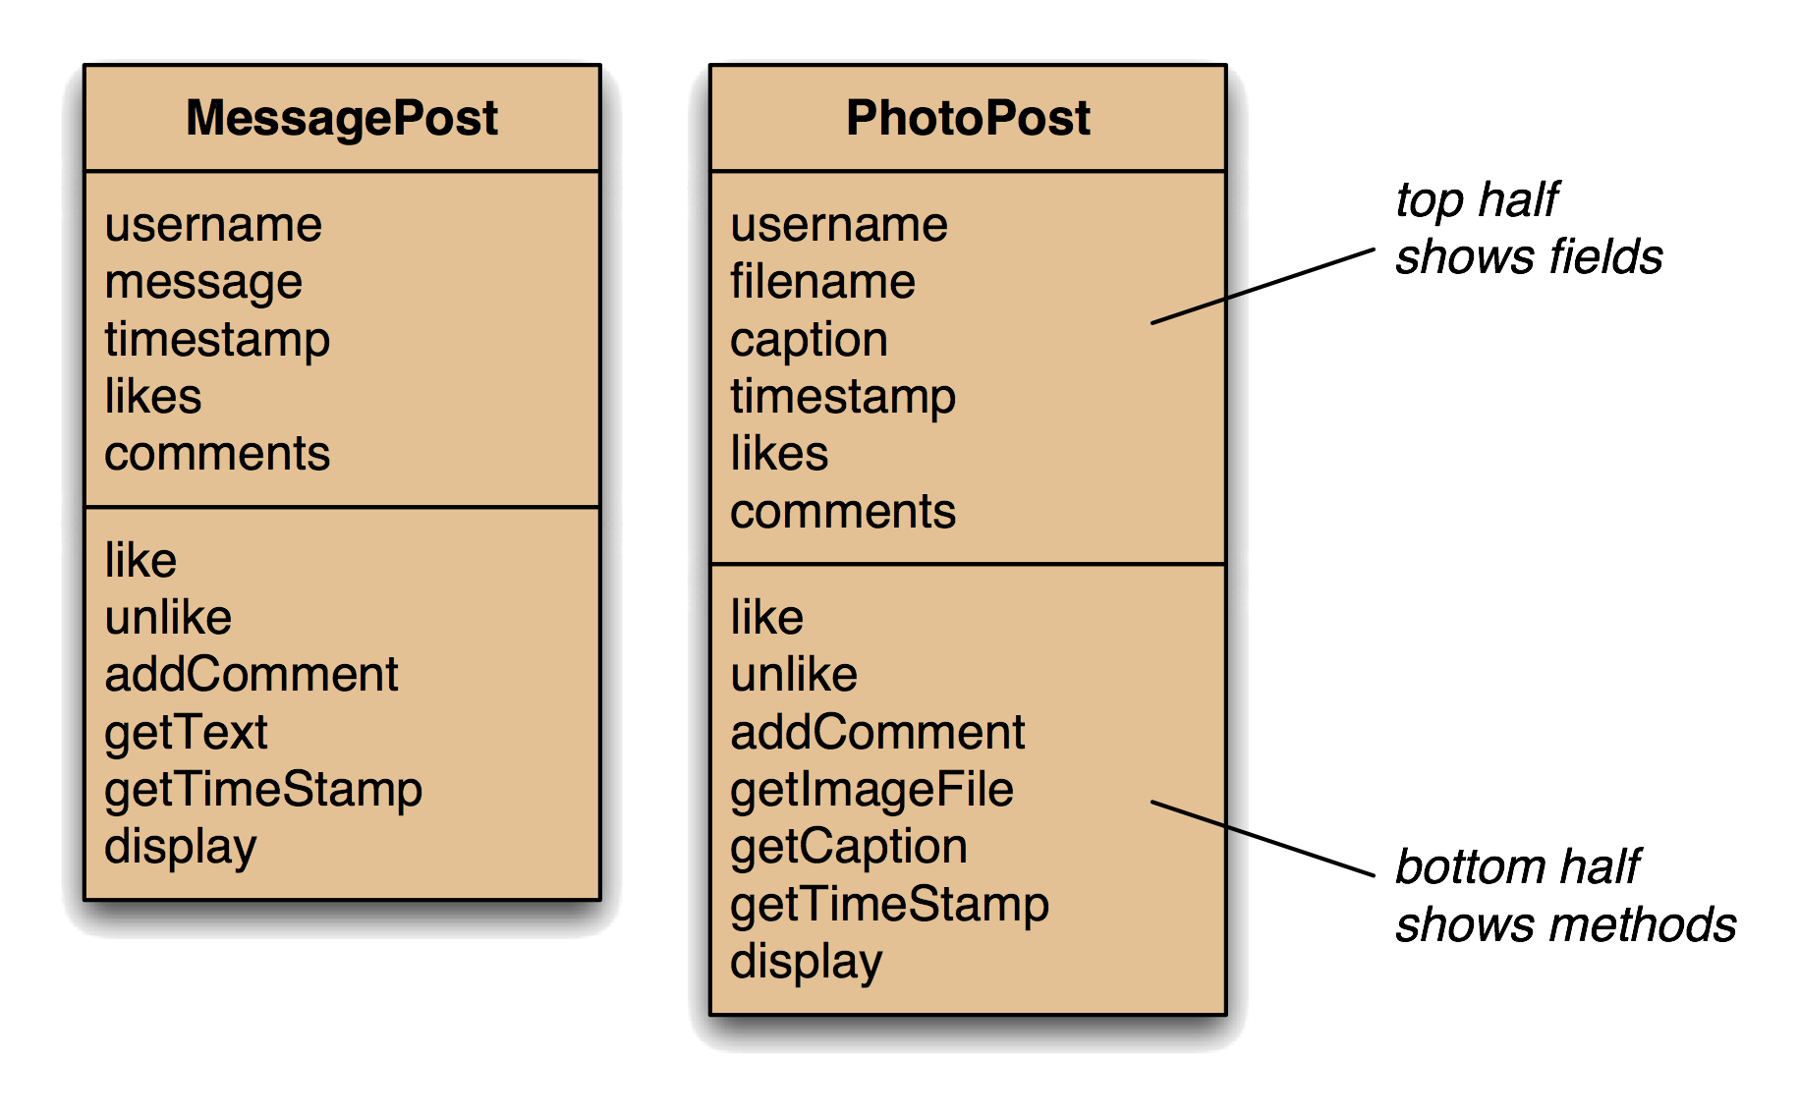
Design

Slide 19
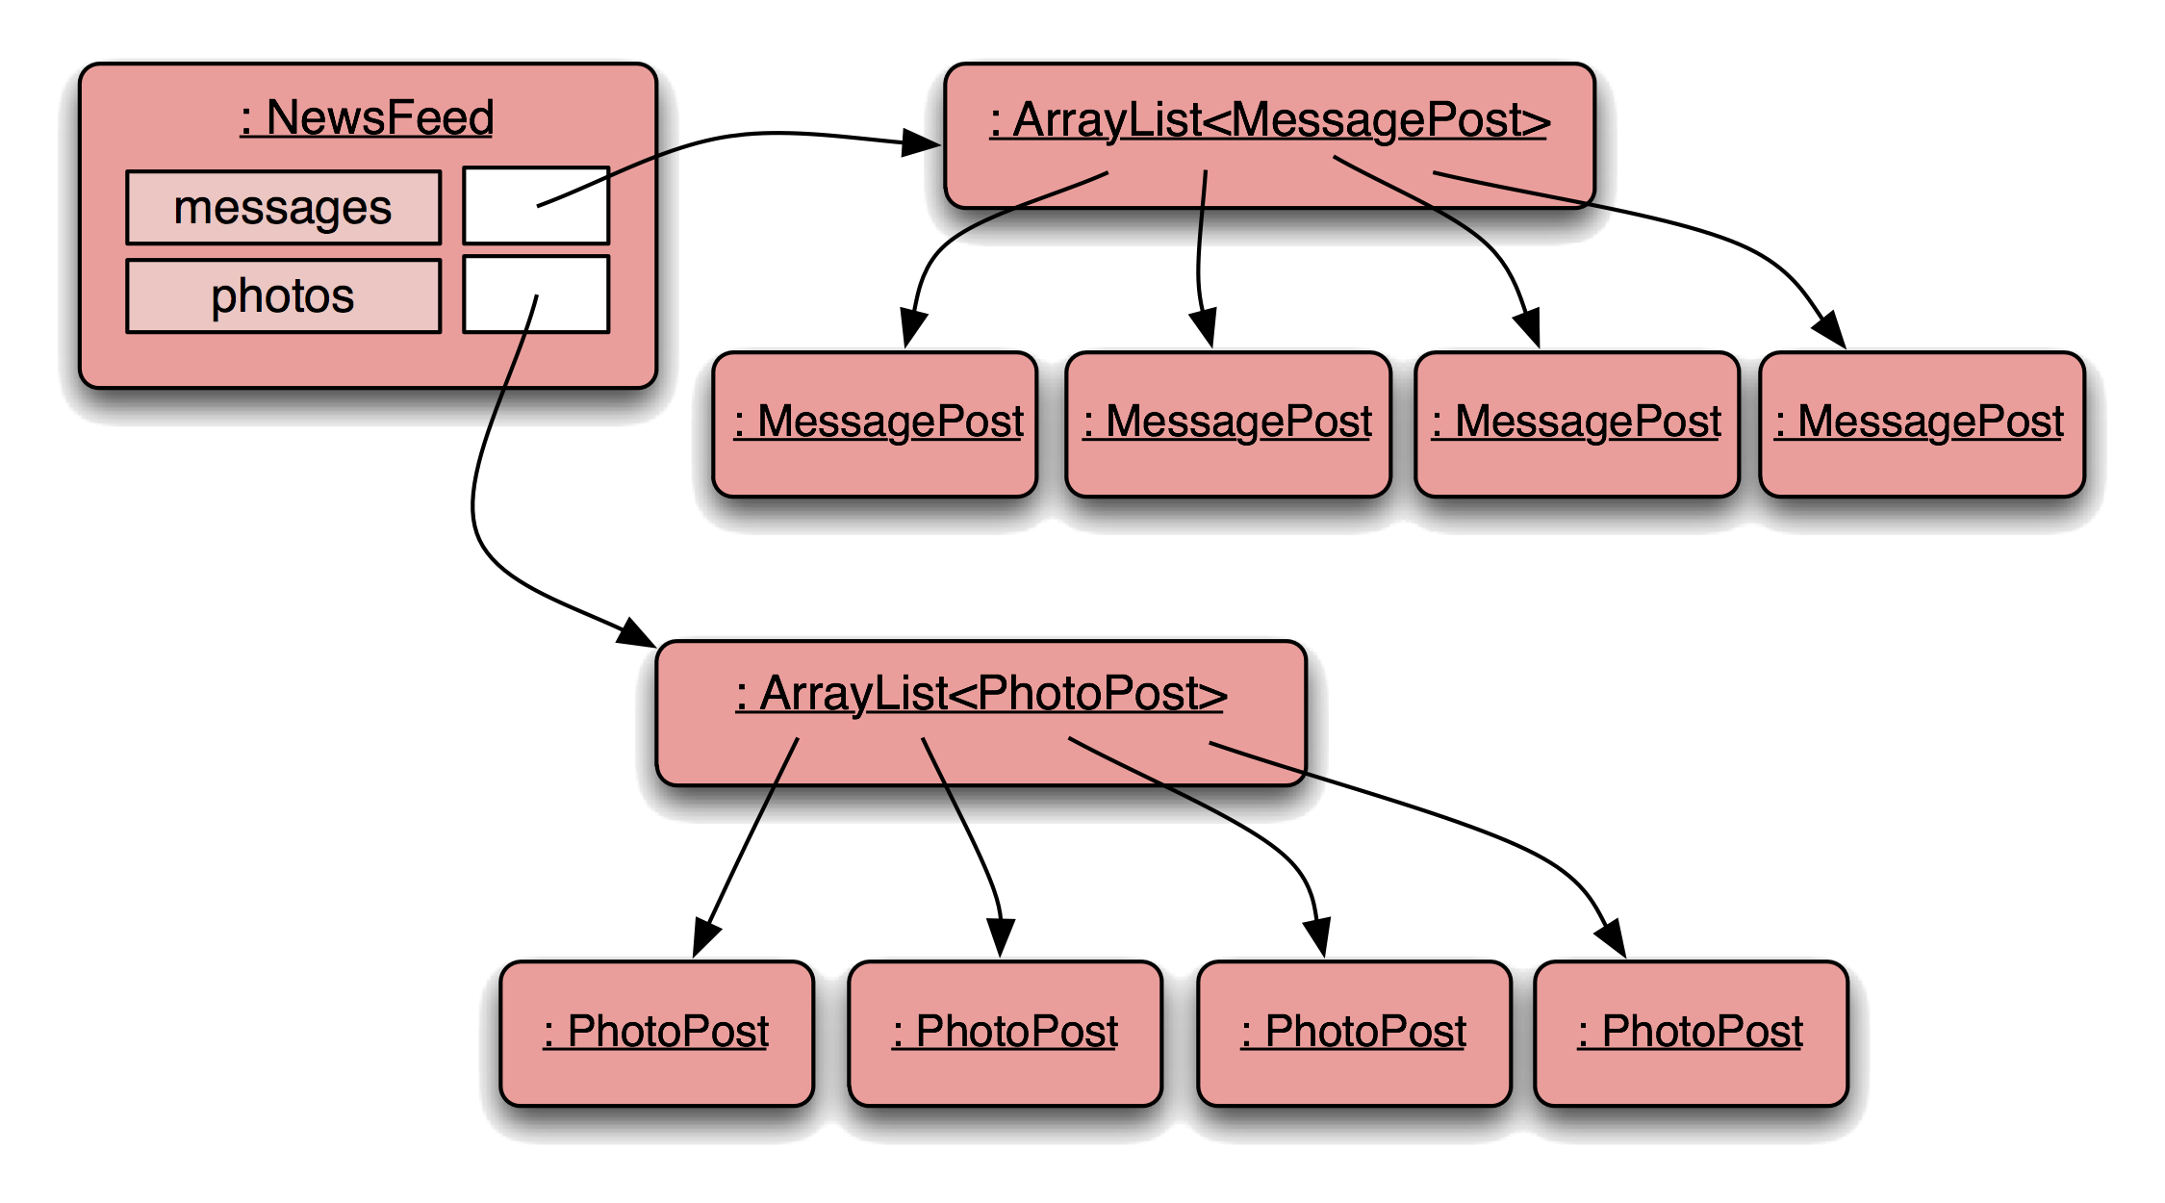
Design

Slide 20
Assessment
We spot the following issues:
Code duplication.
The order in which posts are added is lost.
Both MessagePost and PhotoPost contain like methods that do the same thing.
But they both contain display methods that do very different things.

Slide 21
Assessment
Additionally, this sample has implemented only two types of Post.
Adding the other Post Types requires:
Add a new ArrayList.
Extend the constructor.
Add a new "add" method.
Extend the "show" method.

Slide 22
NewsFeed
private ArrayList <MessagePost> messages;
private ArrayList <PhotoPost> photos;
public NewsFeed () {
this.messages = new ArrayList <> ();
this.photos = new ArrayList <> ();
}
public void addMessagePost (MessagePost m) {
messages.add (m);
}
public void addPhotoPost (PhotoPost p) {
photos.add (p);
}

Slide 23
NewsFeed
public void show () {
for (MessagePost m : messages) {
m.display ();
System.out.println ();
}
for (PhotoPost p : photos) {
p.display ();
System.out.println ();
}
}

Slide 24
To Summarise
There is code duplication:
MessagePost and PhotoPost are very similar (large parts are identical).
NewsFeed must repeat code for each different Post type.
This makes maintenance harder, requires extra typing, and introduces a danger of bugs through sloppy maintenance.
We have a massive code smell, we don't like those!

Slide 25
A Better Design
We reason like this:
NewsFeed is a collection of posts (ArrayList<Post>).
Some posts are messages, some are photos.
NewsFeed will be easier if it handles just Posts.
Post will be a class containing all the common parts.
MessagePost and PhotoPost will contain the specialised parts.

Slide 26
A Better Design
This is, of course, inheritance.
In this scheme, adding a new subclass of Post will be easy.
There is actually no such thing as a Post. Every post in the news feed is going to be one of the specialised types.
We never need to create an instance of Post
We say that Post is abstract.

Slide 27
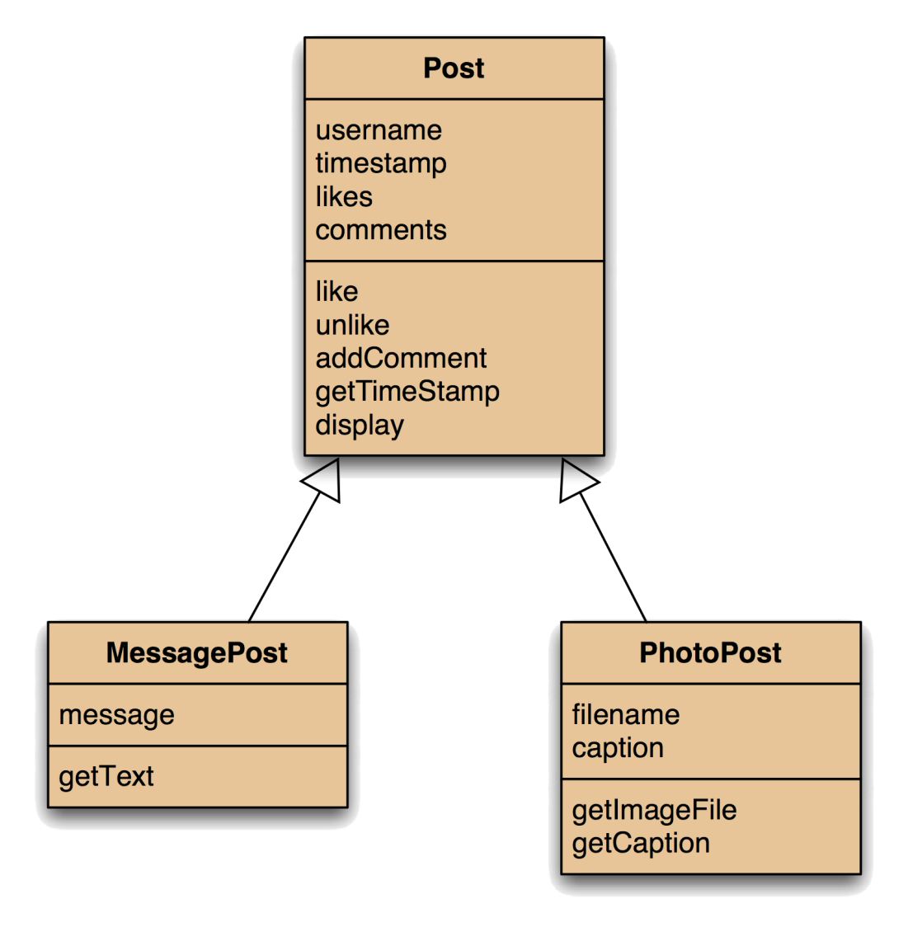
Using Inheritance

Slide 28
Implementation
Define the superclass: Post.
Define subclasses for MessagePost and PhotoPost.
The superclass defines common attributes and methods.
The subclasses inherit the superclass attributes and methods.
The subclasses add their own, specialised, attributes and methods.

Slide 29
Implementation
First, define your superclass:
abstract class Post
{
// Common attributes and methods here.
}
We’ve seen this many times, also, we now have the abstract keyword in the class signature.

Slide 30
Implementation
Now, add a subclass:
public class MessagePost extends Post
{
// Specific attributes and methods here.
}
We’ve also seen this many times, note the addition of the extends keyword. We are extending Post with MessagePost

Slide 31
Implementation
And, add a second subclass:
public class PhotoPost extends Post
{
// Specific attributes and methods here.
}
Still simples.

Slide 32
Implementation
The two subclasses have all the attributes of the superclass, along with their specific ones.
They also have their own methods, plus the methods from the superclass.
To access the values of the attributes of the superclass use getters and setters of the superclass as usual.

Slide 33
Implementation: Constructors
For Post, this is just the same as before:
public Post (String author)
{
username = author;
likes = 0;
comments = new ArrayList <String> ();
}
Notice the parameters in the constructor.

Slide 34
Implementation: Constructors
In the subclasses, there must be a call to the superclass constructor:
public MessagePost (String author, String text)
{
super (author);
message = text;
}
When we create an instance of a subclass, it in-turn effectively creates an instance of its superclass using the super keyword.

Slide 35
Implementation: Constructors
public MessagePost (String author, String text)
{
super (author);
message = text;
}
The super call must be the first statement in the subclass constructor.
If it is missing, Java will insert one implicitly (with no parameters), which is rarely what is wanted.

Slide 36
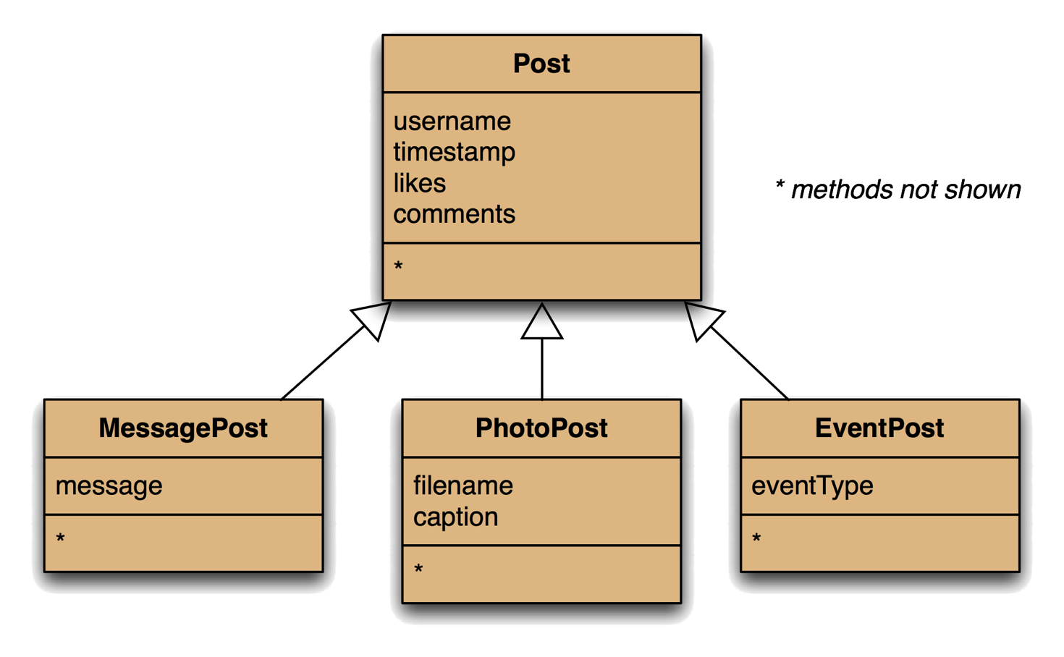
Adding More Post Types

Slide 37
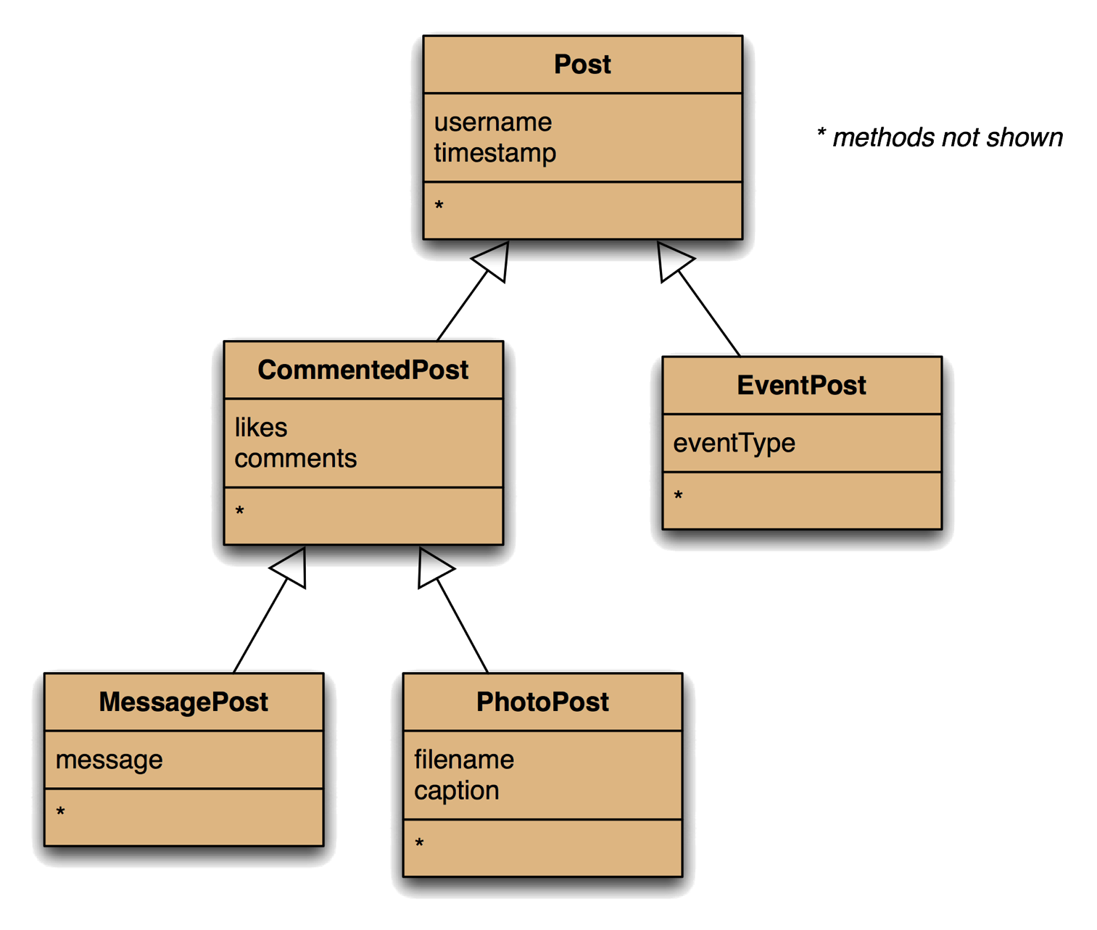
Deeper Hierarchies

Slide 38
Assessment
The new solution is better, but not perfect.
We need to untangle how the two subclasses may have different display methods.
Trying to do so will also highlight other issues, which we will look next time.

Slide 39
Guidance Week
Next week is a standard teaching week.
Any timetabled lectures or tutorials will be on your timetable.
There isn't a lecture or tutorials for programming
My study sessions are running and on your timetable.
If you are behind, need help with outstanding work or have questions about the assignment, please come to my study sessions.

